Slide 1
Normalization

Slide 2
Introduction
Levels at which we can discuss goodness of relation schemas
  Logical (or conceptual) level
  Implementation (or physical storage) level
Approaches to database design:
  Bottom-up or top-down

Slide 3
1 Informal Design Guidelines for Relational Databases (1)
What is relational database design?
  The grouping of attributes to form "good" relation schemas
Two levels of relation schemas
  The logical "user view" level
  The storage "base relation" level
Design is concerned mainly with base relations

Slide 4
Informal Design Guidelines for Relational Databases (2)
We first discuss informal guidelines for good relational design
Then we discuss formal concepts of functional dependencies and normal forms
  - 1NF (First Normal Form)
  - 2NF (Second Normal Form)
  - 3NF (Third Normal Form)
  - BCNF (Boyce-Codd Normal Form)
  - 4NF (Fourth Normal Form)

Slide 5
1.1 Semantics of the Relation Attributes
GUIDELINE 1: Informally, each tuple in a relation should represent one entity or relationship instance. (Applies to individual relations and their attributes).
  Attributes of different entities (EMPLOYEEs, DEPARTMENTs, PROJECTs) should not be mixed in the same relation
  Only foreign keys should be used to refer to other entities
  Entity and relationship attributes should be kept apart as much as possible.
Bottom Line: Design a schema that can be explained easily relation by relation. The semantics of attributes should be easy to interpret.

Slide 6
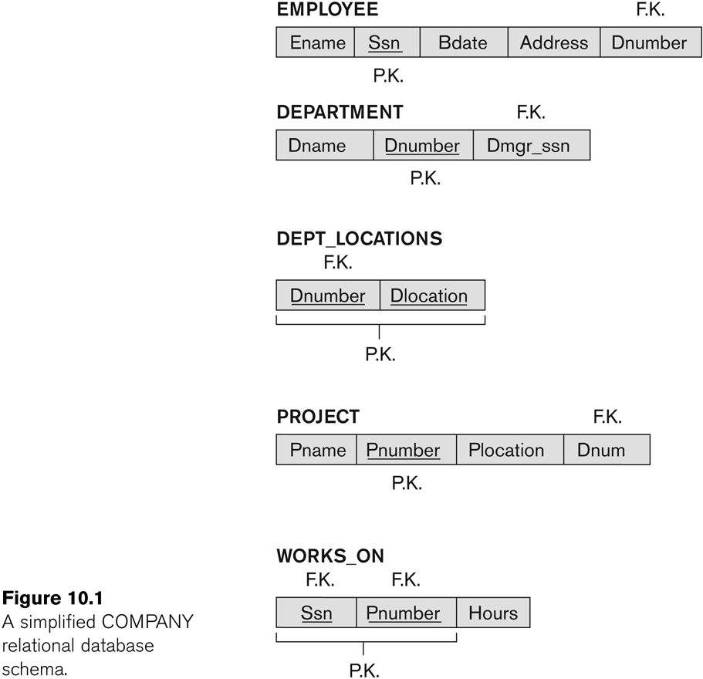
Figure 10.1 A simplified COMPANY relational database schema

Slide 7
1.2 Redundant Information in Tuples and Update Anomalies
Information is stored redundantly
  Wastes storage
  Causes problems with update anomalies
    Insertion anomalies
    Deletion anomalies
    Modification anomalies

Slide 8
EXAMPLE OF AN UPDATE ANOMALY
Consider the relation:
  EMP_PROJ(Emp#, Proj#, Ename, Pname, No_hours)
Update Anomaly:
  Changing the name of project number P1 from “Billing” to “Customer-Accounting” may cause this update to be made for all 100 employees working on project P1.

Slide 9
EXAMPLE OF AN INSERT ANOMALY
Consider the relation:
  EMP_PROJ(Emp#, Proj#, Ename, Pname, No_hours)
Insert Anomaly:
  Cannot insert a project unless an employee is assigned to it.
Conversely
  Cannot insert an employee unless he/she is assigned to a project.

Slide 10
EXAMPLE OF AN DELETE ANOMALY
Consider the relation:
  EMP_PROJ(Emp#, Proj#, Ename, Pname, No_hours)
Delete Anomaly:
  When a project is deleted, it will result in deleting all the employees who work on that project.
  Alternately, if an employee is the sole employee on a project, deleting that employee would result in deleting the corresponding project.
Slide 10- <number>

Slide 11
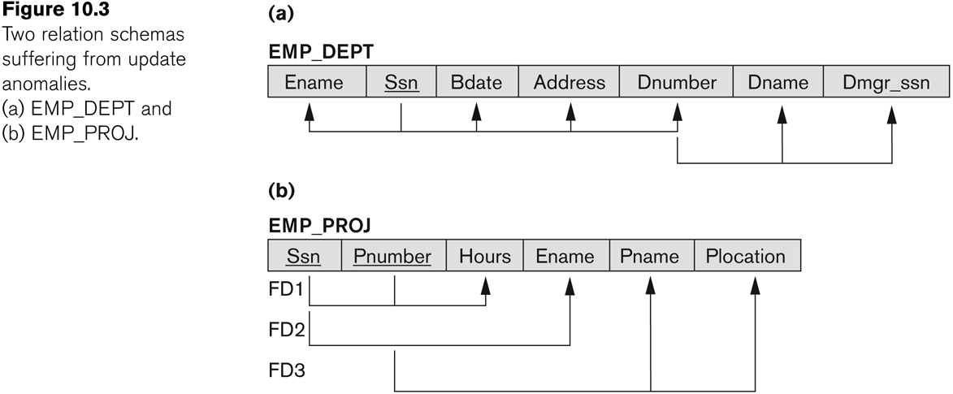
Figure 10.3 Two relation schemas suffering from update anomalies

Slide 12
Guideline to Redundant Information in Tuples and Update Anomalies
GUIDELINE 2:
  Design a schema that does not suffer from the insertion, deletion and update anomalies.
  If there are any anomalies present, then note them so that applications can be made to take them into account.

Slide 13
1.3 Null Values in Tuples
GUIDELINE 3:
  Relations should be designed such that their tuples will have as few NULL values as possible
  Attributes that are NULL frequently could be placed in separate relations (with the primary key)
Reasons for nulls:
  Attribute not applicable or invalid
  Attribute value unknown (may exist)
  Value known to exist, but unavailable

Slide 14
1.4 Spurious Tuples
Bad designs for a relational database may result in erroneous results for certain JOIN operations
The "lossless join" property is used to guarantee meaningful results for join operations
GUIDELINE 4:
  The relations should be designed to satisfy the lossless join condition.
  No spurious tuples should be generated by doing a natural-join of any relations.

Slide 15
2.1 Functional Dependencies (1)
Functional dependencies (FDs)
  Are used to specify formal measures of the "goodness" of relational designs
  And keys are used to define normal forms for relations
  Are constraints that are derived from the meaning and interrelationships of the data attributes
A set of attributes X functionally determines a set of attributes Y if the value of X determines a unique value for Y

Slide 16
Functional Dependencies (2)
X -> Y holds if whenever two tuples have the same value for X, they must have the same value for Y
  For any two tuples t1 and t2 in any relation instance r(R): If t1[X]=t2[X], then t1[Y]=t2[Y]
X -> Y in R specifies a constraint on all relation instances r(R)
FDs are derived from the real-world constraints on the attributes

Slide 17
Examples of FD constraints (1)
Social security number determines employee name
  SSN -> ENAME
Project number determines project name and location
  PNUMBER -> {PNAME, PLOCATION}
Employee ssn and project number determines the hours per week that the employee works on the project
  {SSN, PNUMBER} -> HOURS

Slide 18
Examples of FD constraints (2)
FD is a property of the attributes in the schema R
The constraint must hold on every relation instance r(R)
If K is a key of R, then K functionally determines all attributes in R
  (since we never have two distinct tuples with t1[K]=t2[K])

Slide 19
2.2 Inference Rules for FDs (1)
Given a set of FDs F, we can infer additional FDs that hold whenever the FDs in F hold
Armstrong's inference rules:
  IR1. (Reflexive) If Y subset-of X, then X -> Y
  IR2. (Augmentation) If X -> Y, then XZ -> YZ
    (Notation: XZ stands for X U Z)
  IR3. (Transitive) If X -> Y and Y -> Z, then X -> Z
IR1, IR2, IR3 form a sound and complete set of inference rules

Slide 20
Definition
This is the process which allows you to remove redundant data within your database.
This involves restructuring the tables to successively meeting higher forms of Normalization.
A properly normalized database should have the following characteristics
  Scalar values in each fields
  Absence of redundancy.
  Minimal use of null values.
  Minimal loss of information.

Slide 21
Levels of Normalization
Levels of normalization based on the amount of redundancy in the database.
Various levels of normalization are:
  First Normal Form (1NF)
  Second Normal Form (2NF)
  Third Normal Form (3NF)
  Boyce-Codd Normal Form (BCNF)
  Fourth Normal Form (4NF)
  Fifth Normal Form (5NF)
  Domain Key Normal Form (DKNF)
Redundancy
Number of Tables
Complexity
Most databases should be 3NF or BCNF in order to avoid the database anomalies.

Slide 22
Levels of Normalization
1NF
2NF
3NF
4NF
5NF
DKNF
Each higher level is a subset of the lower level

Slide 23
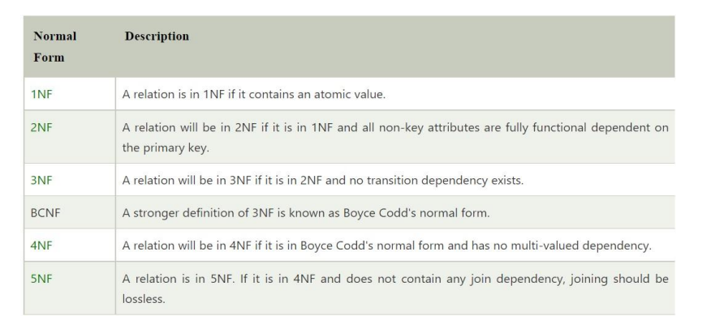

Slide 24
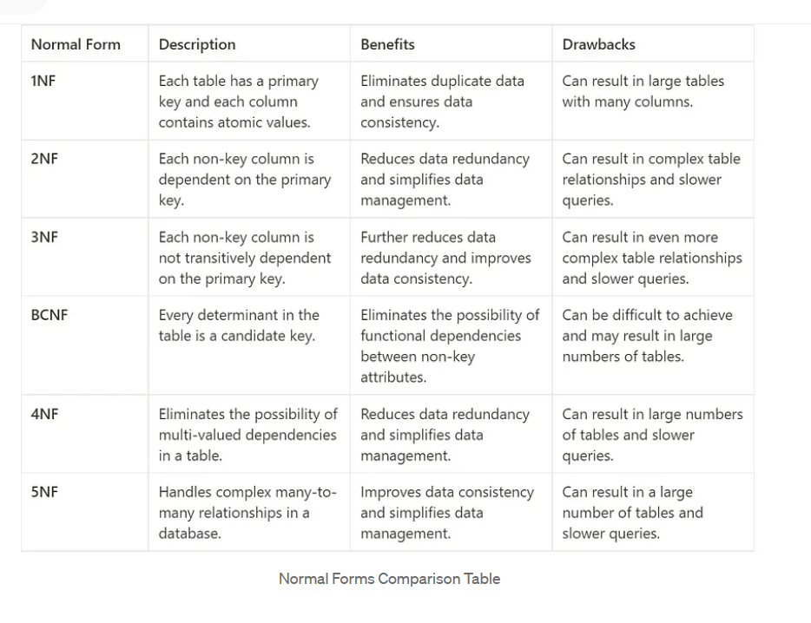

Slide 25
First Normal Form (1NF)
A table is considered to be in 1NF if all the fields contain
only scalar values (as opposed to list of values).
Example (Not 1NF)
ISBN
Title
AuName
AuPhone
PubName
PubPhone
Price
0-321-32132-1
Balloon
Sleepy, Snoopy, Grumpy
321-321-1111, 232-234-1234, 665-235-6532
Small House
714-000-0000
$34.00
0-55-123456-9
Main Street
Jones, Smith
123-333-3333, 654-223-3455
Small House
714-000-0000
$22.95
0-123-45678-0
Ulysses
Joyce
666-666-6666
Alpha Press
999-999-9999
$34.00
1-22-233700-0
Visual Basic
Roman
444-444-4444
Big House
123-456-7890
$25.00
AuName and AuPhone columns are not scalar
Notes:
Having scalar values also means that all instances of a record type must contain the same number of fields.
A table not in first normal form is called un normalized

Slide 26
1NF - Decomposition
Place all items that appear in the repeating group in a new table
Designate a primary key for each new table produced.
Duplicate in the new table the primary key of the table from which the repeating group was extracted or vice versa.
Example (1NF)
ISBN
AuName
AuPhone
0-321-32132-1
Sleepy
321-321-1111
ISBN
Title
PubName
PubPhone
Price
0-321-32132-1
Snoopy
232-234-1234
0-321-32132-1
Balloon
Small House
714-000-0000
$34.00
0-321-32132-1
Grumpy
665-235-6532
0-55-123456-9
Main Street
Small House
714-000-0000
$22.95
0-55-123456-9
Jones
123-333-3333
0-123-45678-0
Ulysses
Alpha Press
999-999-9999
$34.00
0-55-123456-9
Smith
654-223-3455
1-22-233700-0
Visual Basic
Big House
123-456-7890
$25.00
0-123-45678-0
Joyce
666-666-6666
1-22-233700-0
Roman
444-444-4444
Notes:
1. The designated key will be the primary key of the original table concatenated with one or more data items from the new table.
For the first table the primary key is ISBN
For the second table the primary key is ISBN + Author Name

Slide 27
Functional Dependencies
If one set of attributes in a table determines another set of attributes in the table, then the second set of attributes is said to be functionally dependent on the first set of attributes.
Example 1
ISBN
Title
Price
Table Scheme: {ISBN, Title, Price}
Functional Dependencies: {ISBN} → {Title}
{ISBN} → {Price}
0-321-32132-1
Balloon
$34.00
0-55-123456-9
Main Street
$22.95
0-123-45678-0
Ulysses
$34.00
1-22-233700-0
Visual Basic
$25.00
Notes:
Notes to Instructor: Need more rigor in the functional dependencies. With a few examples. May be create a class assignment for functional dependencies.

Slide 28
Functional Dependencies
Example 2
Table Scheme: {PubID, PubName, PubPhone}
Functional Dependencies: {PubId} → {PubPhone}
{PubId} → {PubName}
{PubName, PubPhone} → {PubID}
PubID
PubName
PubPhone
1
Big House
999-999-9999
2
Small House
123-456-7890
3
Alpha Press
111-111-1111
Example 3
AuID
AuName
AuPhone
Table Scheme: {AuID, AuName, AuPhone}
Functional Dependencies: {AuId} → {AuPhone}
{AuId} → {AuName}
{AuName, AuPhone} → {AuID}
1
Sleepy
321-321-1111
2
Snoopy
232-234-1234
3
Grumpy
665-235-6532
4
Jones
123-333-3333
5
Smith
654-223-3455
6
Joyce
666-666-6666
7
Roman
444-444-4444

Slide 29
FD – Example
Database to track reviews of papers submitted to an academic conference. Prospective authors submit papers for review and possible acceptance in the published conference proceedings. Details of the entities
  Author information includes a unique author number, a name, a mailing address, and a unique (optional) email address.
  Paper information includes the primary author, the paper number, the title, the abstract, and review status (pending, accepted,rejected)
  Reviewer information includes the reviewer number, the name, the mailing address, and a unique (optional) email address
  A completed review includes the reviewer number, the date, the paper number, comments to the authors, comments to the program chairperson, and ratings (overall, originality, correctness, style, clarity)

Slide 30
FD – Example
Functional Dependencies
  AuthNo → AuthName, AuthEmail, AuthAddress
  AuthEmail → AuthNo
  PaperNo → Primary-Auth, Title, Abstract, Status
  RevNo → RevName, RevEmail, RevAddress
  RevEmail → RevNo
  RevNo, PaperNo → AuthComm, Prog-Comm, Date, Rating1, Rating2, Rating3, Rating4, Rating5

Slide 31
Second Normal Form (2NF)
For a table to be in 2NF, there are two requirements
  The database is in first normal form
  All nonkey attributes in the table must be functionally dependent on the entire primary key
Note: Remember that we are dealing with non-key attributes
Example 1 (Not 2NF)
Scheme → {Title, PubId, AuId, Price, AuAddress}
  Key → {Title, PubId, AuId}
  {Title, PubId, AuID} → {Price}
  {AuID} → {AuAddress}
  AuAddress does not belong to a key
  AuAddress functionally depends on AuId which is a subset of a key

Slide 32
Second Normal Form (2NF)
Example 2 (Not 2NF)
Scheme → {City, Street, HouseNumber, HouseColor, CityPopulation}
  key → {City, Street, HouseNumber}
  {City, Street, HouseNumber} → {HouseColor}
  {City} → {CityPopulation}
  CityPopulation does not belong to any key.
  CityPopulation is functionally dependent on the City which is a proper subset of the key
Example 3 (Not 2NF)
Scheme → {studio, movie, budget, studio_city}
  Key → {studio, movie}
  {studio, movie} → {budget}
  {studio} → {studio_city}
  studio_city is not a part of a key
  studio_city functionally depends on studio which is a proper subset of the key
Notes:
Let us consider the problems with the movie studio database:
Redundancy – City Population is repeated many times
Insertion anomaly – Whenever we add a new record we have to add unnecessary information. We can not add record until we know information about the city population
Deletion anomaly – Whenever we delete a record, useful information is deleted.
Update anomaly – The City Population needs to be updated in more than one location if it changes.

Slide 33
2NF - Decomposition
If a data item is fully functionally dependent on only a part of the primary key, move that data item and that part of the primary key to a new table.
If other data items are functionally dependent on the same part of the key, place them in the new table also
Make the partial primary key copied from the original table the primary key for the new table. Place all items that appear in the repeating group in a new table
Example 1 (Convert to 2NF)
  Old Scheme → {Title, PubId, AuId, Price, AuAddress}
  New Scheme → {Title, PubId, AuId, Price}
  New Scheme → {AuId, AuAddress}
Notes:
If there is a table with columns A,B,C,D with Primary Key (A,B) & D is dependant on A (alone) then to be 2NF, you should reduce (split) tables as:
Table with columns A,D with Primary Key (A)
Table with columns A,B,C with Primary Key (A,B)

Slide 34
2NF - Decomposition
Example 2 (Convert to 2NF)
  Old Scheme → {Studio, Movie, Budget, StudioCity}
  New Scheme → {Movie, Studio, Budget}
  New Scheme → {Studio, City}
Example 3 (Convert to 2NF)
  Old Scheme → {City, Street, HouseNumber, HouseColor, CityPopulation}
  New Scheme → {City, Street, HouseNumber, HouseColor}
  New Scheme → {City, CityPopulation}

Slide 35
Third Normal Form (3NF)
This form dictates that all non-key attributes of a table must be functionally dependent on a candidate key i.e. there can be no interdependencies among non-key attributes.
For a table to be in 3NF, there are two requirements
  The table should be second normal form
  No attribute is transitively dependent on the primary key
Example (Not in 3NF)
Scheme → {Title, PubID, PageCount, Price }
  Key → {Title, PubId}
  {Title, PubId} → {PageCount}
  {PageCount} → {Price}
  Both Price and PageCount depend on a key hence 2NF
  Transitively {Title, PubID} → {Price} hence not in 3NF
Notes:
In the Book Schema Third Normal Form is violated since a non-key field is dependent on another non-key field and is transitively dependent on the primary key.

Slide 36
Third Normal Form (3NF)
Example 2 (Not in 3NF)
Scheme → {Studio, StudioCity, CityTemp}
  Primary Key → {Studio}
  {Studio} → {StudioCity}
  {StudioCity} → {CityTemp}
  {Studio} → {CityTemp}
  Both StudioCity and CityTemp depend on the entire key hence 2NF
  CityTemp transitively depends on Studio hence violates 3NF
Example 3 (Not in 3NF)
Scheme → {BuildingID, Contractor, Fee}
  Primary Key → {BuildingID}
  {BuildingID} → {Contractor}
  {Contractor} → {Fee}
  {BuildingID} → {Fee}
  Fee transitively depends on the BuildingID
  Both Contractor and Fee depend on the entire key hence 2NF
BuildingID
Contractor
Fee
100
Randolph
1200
150
Ingersoll
1100
200
Randolph
1200
250
Pitkin
1100
300
Randolph
1200
Notes:
Let us consider the problems with the movie studio database:
Redundancy – City Population is repeated many times
Insertion anomaly – Whenever we add a new record we have to add unnecessary information. We can not add record until we know information about the city population
Deletion anomaly – Whenever we delete a record, useful information is deleted.
Update anomaly – The City Population needs to be updated in more than one location if it changes.

Slide 37
3NF - Decomposition
Move all items involved in transitive dependencies to a new entity.
Identify a primary key for the new entity.
Place the primary key for the new entity as a foreign key on the original entity.
Example 1 (Convert to 3NF)
  Old Scheme → {Title, PubID, PageCount, Price }
  New Scheme → {PubID, PageCount, Price}
  New Scheme → {Title, PubID, PageCount}
Notes:
If there is a table with columns A,B,C with Primary Key (A) and C is dependant on B (B → C) then to be 3NF, the tables become
Table with columns B,C with Primary Key (B)
Table with fields A,B with Primary Key ( A), and Foreign Key (B)

Slide 38
3NF - Decomposition
Example 2 (Convert to 3NF)
  Old Scheme → {Studio, StudioCity, CityTemp}
  New Scheme → {Studio, StudioCity}
  New Scheme → {StudioCity, CityTemp}
Example 3 (Convert to 3NF)
  Old Scheme → {BuildingID, Contractor, Fee}
  New Scheme → {BuildingID, Contractor}
  New Scheme → {Contractor, Fee}
BuildingID
Contractor
Contractor
Fee
100
Randolph
Randolph
1200
150
Ingersoll
Ingersoll
1100
200
Randolph
Pitkin
1100
250
Pitkin
300
Randolph

Slide 39
Boyce-Codd Normal Form (BCNF)
BCNF does not allow dependencies between attributes that belong to candidate keys.
BCNF is a refinement of the third normal form in which it drops the restriction of a non-key attribute from the 3rd normal form.
Third normal form and BCNF are not same if the following conditions are true:
  The table has two or more candidate keys
  At least two of the candidate keys are composed of more than one attribute
  The keys are not disjoint i.e. The composite candidate keys share some attributes
Example 1 - Address (Not in BCNF)
Scheme → {City, Street, ZipCode }
  Key1 → {City, Street }
  Key2 → {ZipCode, Street}
  No non-key attribute hence 3NF
  {City, Street} → {ZipCode}
  {ZipCode} → {City}
  Dependency between attributes belonging to a key
Notes:
The second and third normal forms assume that all attributes not part of the candidate keys depend on the candidate keys but does not deal with dependencies within the keys. BCNF deals with such dependencies.
Under third normal form all non-key columns must be functionally dependent on a candidate key. Under BCNF, even columns that are part of a candidate key must be dependent on another candidate key, if they have a dependency at all.
For most tables third normal form and BCNF are the same. Third normal form does not cover some specific cases for which BCNF was created. Third normal form and BCNF are not same if the following conditions are true:
The table has two or more candidate keys
At least two of the candidate keys are composed of more than one attribute
The keys are not disjoint i.e. The composite candidate keys share some attributes

Slide 40
Boyce Codd Normal Form (BCNF)
Example 2 - Movie (Not in BCNF)
Scheme → {MovieTitle, MovieID, PersonName, Role, Payment }
  Key1 → {MovieTitle, PersonName}
  Key2 → {MovieID, PersonName}
  Both role and payment functionally depend on both candidate keys thus 3NF
  {MovieID} → {MovieTitle}
  Dependency between MovieID & MovieTitle Violates BCNF
Example 3 - Consulting (Not in BCNF)
Scheme → {Client, Problem, Consultant}
  Key1 → {Client, Problem}
  Key2 → {Client, Consultant}
  No non-key attribute hence 3NF
  {Client, Problem} → {Consultant}
  {Client, Consultant} → {Problem}
  Dependency between attributess belonging to keys violates BCNF
Notes:
A management consulting firm has several clients and consultants. A client can have several problems and the same problem can be an issue for several clients. Each consultant specializes in only one problem type (e. g marketing, production) but several consultants could advise on one problem. For each problem, the client is advised by only one consultant.

Slide 41
BCNF - Decomposition
Place the two candidate primary keys in separate entities
Place each of the remaining data items in one of the resulting entities according to its dependency on the primary key.
Example 1 (Convert to BCNF)
  Old Scheme → {City, Street, ZipCode }
  New Scheme1 → {ZipCode, Street}
  New Scheme2 → {City, Street}
Loss of relation {ZipCode} → {City}
  Alternate New Scheme1 → {ZipCode, Street }
  Alternate New Scheme2 → {ZipCode, City}
Notes:
If there is a table with columns A,B,C with Primary Key (A) and C is dependant on B (B → C) then to be 3NF, the tables become
Table with columns B,C with Primary Key (B)
Table with fields A,B with Primary Key ( A), and Foreign Key (B)

Slide 42
Decomposition – Loss of Information
If decomposition does not cause any loss of information it is called a lossless decomposition.
If a decomposition does not cause any dependencies to be lost it is called a dependency-preserving decomposition.
Any table scheme can be decomposed in a lossless way into a collection of smaller schemas that are in BCNF form. However the dependency preservation is not guaranteed.
Any table can be decomposed in a lossless way into 3rd normal form that also preserves the dependencies.
  3NF may be better than BCNF in some cases
Use your own judgment when decomposing schemas

Slide 43
BCNF - Decomposition
Example 2 (Convert to BCNF)
  Old Scheme → {MovieTitle, MovieID, PersonName, Role, Payment }
  New Scheme → {MovieID, PersonName, Role, Payment}
  New Scheme → {MovieTitle, PersonName}
Loss of relation {MovieID} → {MovieTitle}
  New Scheme → {MovieID, PersonName, Role, Payment}
  New Scheme → {MovieID, MovieTitle}
We got the {MovieID} → {MovieTitle} relationship back
Example 3 (Convert to BCNF)
  Old Scheme → {Client, Problem, Consultant}
  New Scheme → {Client, Consultant}
  New Scheme → {Client, Problem}

Slide 44
Fourth Normal Form (4NF)
Fourth normal form eliminates independent many-to-one relationships between columns.
To be in Fourth Normal Form,
  a relation must first be in Boyce-Codd Normal Form.
  a given relation may not contain more than one multi-valued attribute.
Example (Not in 4NF)
  Scheme → {MovieName, ScreeningCity, Genre)
  Primary Key: {MovieName, ScreeningCity, Genre)
  All columns are a part of the only candidate key, hence BCNF
  Many Movies can have the same Genre
  Many Cities can have the same movie
  Violates 4NF
Movie
ScreeningCity
Genre
Hard Code
Los Angles
Comedy
Hard Code
New York
Comedy
Bill Durham
Santa Cruz
Drama
Bill Durham
Durham
Drama
The Code Warrier
New York
Horror

Slide 45
Fourth Normal Form (4NF)
Example 2 (Not in 4NF)
Scheme → {Manager, Child, Employee}
  Primary Key → {Manager, Child, Employee}
  Each manager can have more than one child
  Each manager can supervise more than one employee
  4NF Violated
Example 3 (Not in 4NF)
Scheme → {Employee, Skill, ForeignLanguage}
  Primary Key → {Employee, Skill, Language }
  Each employee can speak multiple languages
  Each employee can have multiple skills
  Thus violates 4NF
Manager
Child
Employee
Jim
Beth
Alice
Mary
Bob
Jane
Mary
NULL
Adam
Employee
Skill
Language
1234
Cooking
French
1234
Cooking
German
1453
Carpentry
Spanish
1453
Cooking
Spanish
2345
Cooking
Spanish
Notes:
These cause update, addition and deletion anomalies.
Insertion anomaly is that entity integrity would be violated if you tried to add a new employee who did not speak a foreign language.
Update anomalies would occur if you tried to change Cooking to Chef.

Slide 46
4NF - Decomposition
Move the two multi-valued relations to separate tables
Identify a primary key for each of the new entity.
Example 1 (Convert to 3NF)
  Old Scheme → {MovieName, ScreeningCity, Genre}
  New Scheme → {MovieName, ScreeningCity}
  New Scheme → {MovieName, Genre}
Movie
Genre
Movie
ScreeningCity
Hard Code
Comedy
Hard Code
Los Angles
Bill Durham
Drama
Hard Code
New York
The Code Warrier
Horror
Bill Durham
Santa Cruz
Bill Durham
Durham
The Code Warrier
New York

Slide 47
4NF - Decomposition
Example 2 (Convert to 4NF)
  Old Scheme → {Manager, Child, Employee}
  New Scheme → {Manager, Child}
  New Scheme → {Manager, Employee}
Example 3 (Convert to 4NF)
  Old Scheme → {Employee, Skill, ForeignLanguage}
  New Scheme → {Employee, Skill}
  New Scheme → {Employee, ForeignLanguage}
Manager
Child
Manager
Employee
Jim
Beth
Jim
Alice
Mary
Bob
Mary
Jane
Mary
Adam
Employee
Skill
Employee
Language
1234
Cooking
1234
French
1453
Carpentry
1234
German
1453
Cooking
1453
Spanish
2345
Cooking
2345
Spanish

Slide 48
Fifth Normal Form (5NF)
Fifth normal form is satisfied when all tables are broken into as many tables as possible in order to avoid redundancy. Once it is in fifth normal form it cannot be broken into smaller relations without changing the facts or the meaning.

Slide 49
Domain Key Normal Form (DKNF)
The relation is in DKNF when there can be no insertion or deletion anomalies in the database.

Slide 50
Definitions of Keys and Attributes Participating in Keys (2)
If a relation schema has more than one key, each is called a candidate key.
  One of the candidate keys is arbitrarily designated to be the primary key, and the others are called secondary keys.
A Prime attribute must be a member of some candidate key
A Nonprime attribute is not a prime attribute—that is, it is not a member of any candidate key.
Slide 10- <number>

Slide 51
3.2 First Normal Form
Disallows
  composite attributes
  multivalued attributes
  nested relations; attributes whose values for an individual tuple are non-atomic
Considered to be part of the definition of relation
Slide 10- <number>

Slide 52

Figure 10.8 Normalization into 1NF
Slide 10- <number>

Slide 53
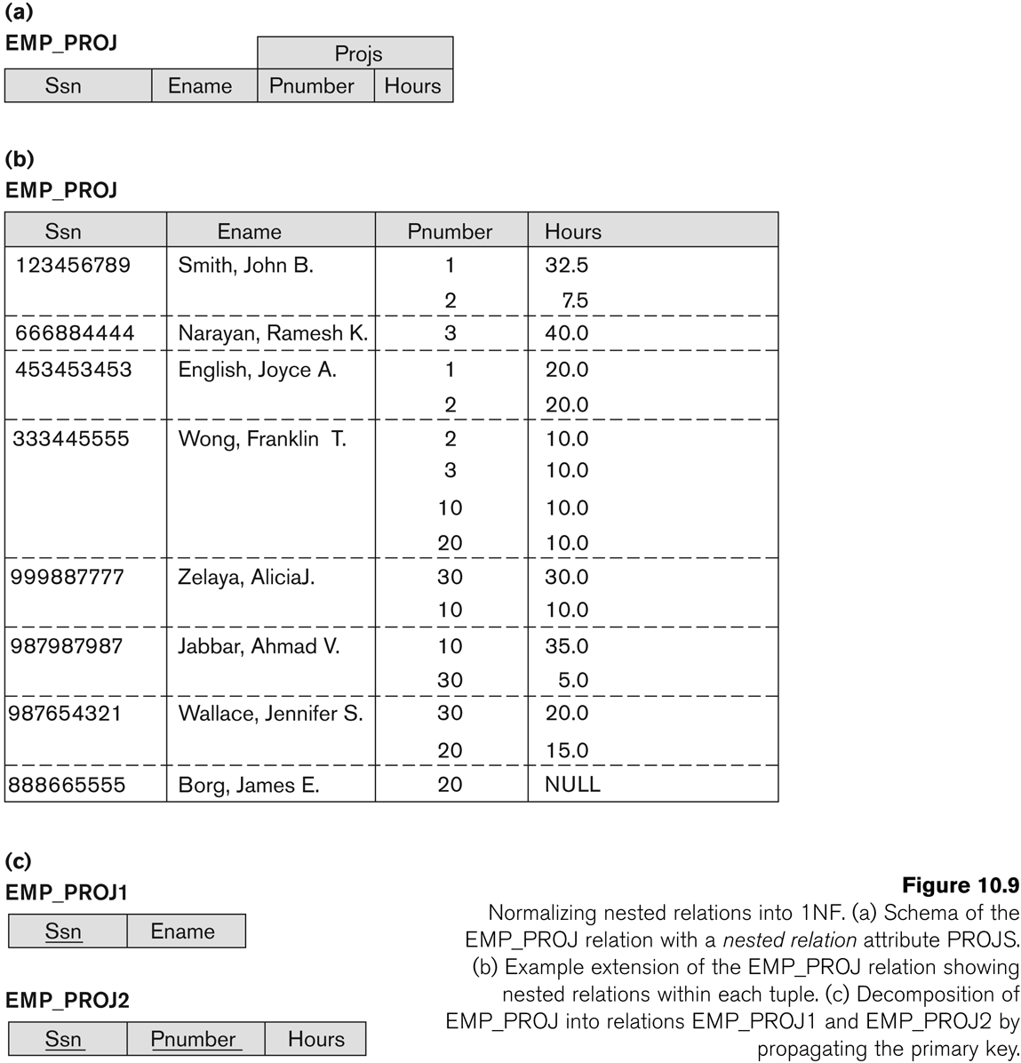
Figure 10.9 Normalization nested relations into 1NF
Slide 10- <number>

Slide 54
3.3 Second Normal Form (1)
Uses the concepts of FDs, primary key
Definitions
  Prime attribute: An attribute that is member of the primary key K
  Full functional dependency: a FD Y -> Z where removal of any attribute from Y means the FD does not hold any more
Examples:
  {SSN, PNUMBER} -> HOURS is a full FD since neither SSN -> HOURS nor PNUMBER -> HOURS hold
  {SSN, PNUMBER} -> ENAME is not a full FD (it is called a partial dependency ) since SSN -> ENAME also holds
Slide 10- <number>

Slide 55
Second Normal Form (2)
A relation schema R is in second normal form (2NF) if every non-prime attribute A in R is fully functionally dependent on the primary key
R can be decomposed into 2NF relations via the process of 2NF normalization
Slide 10- <number>

Slide 56
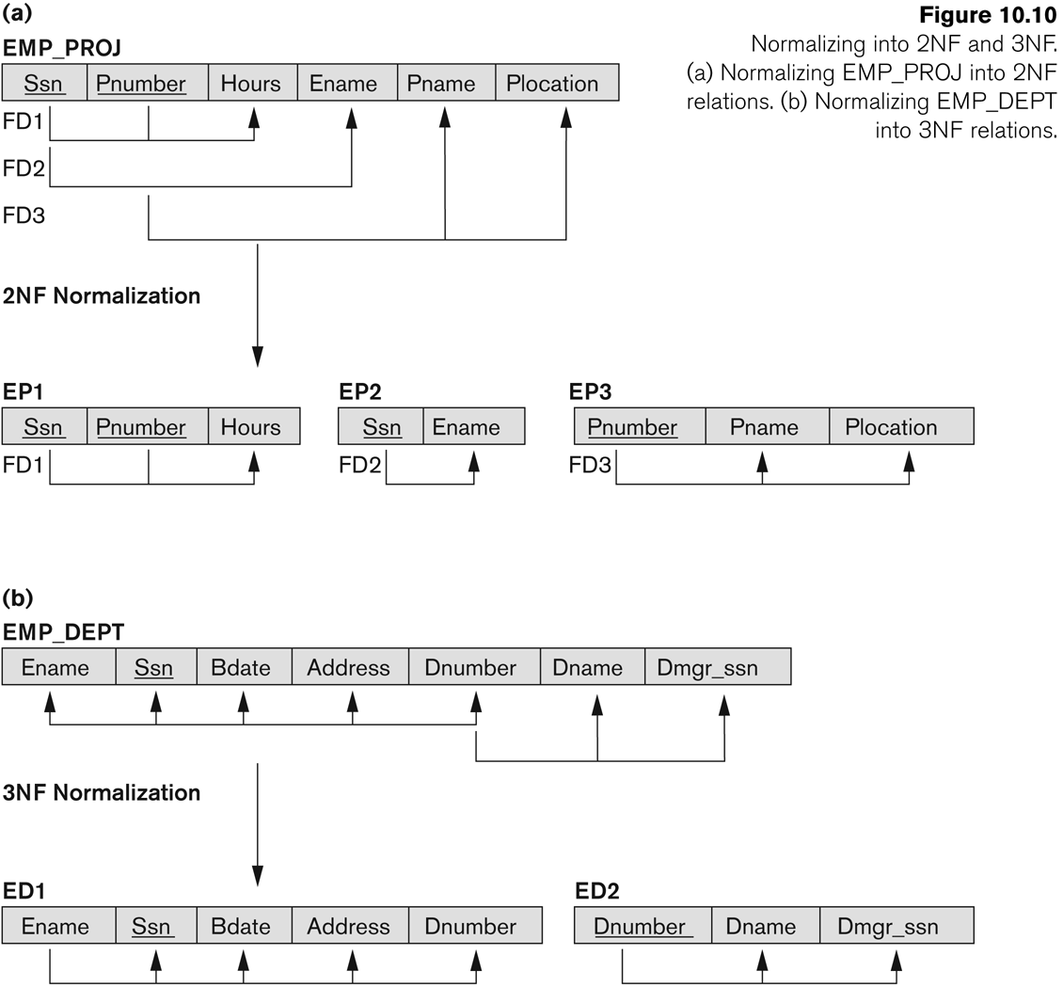
Figure 10.10 Normalizing into 2NF and 3NF
Slide 10- <number>

Slide 57
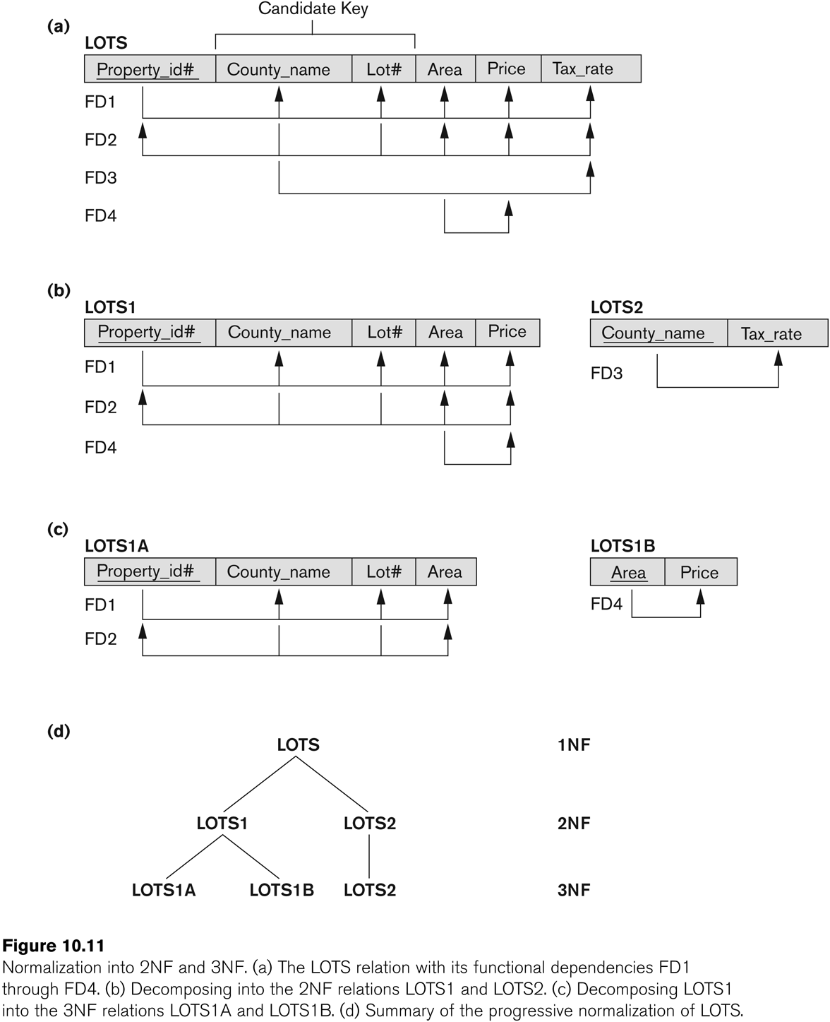
Figure 10.11 Normalization into 2NF and 3NF

